Slide 1

Optical charting of brain-wide activation maps neuron by neuron
L. Silvestri, N. Rudinskiy, M. Paciscopi, M.C. Müllenbroich, I. Costantini, L. Sacconi, P. Frasconi, B.T. Hyman & F.S. Pavone
Focus on Microscopy 2015
Göttingen, Germany, April 1st, 2015

Slide 2

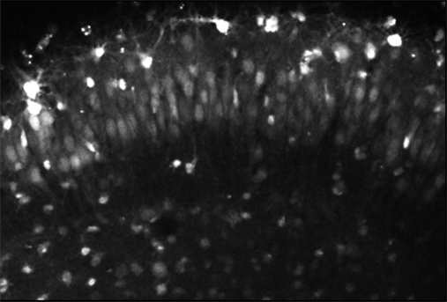
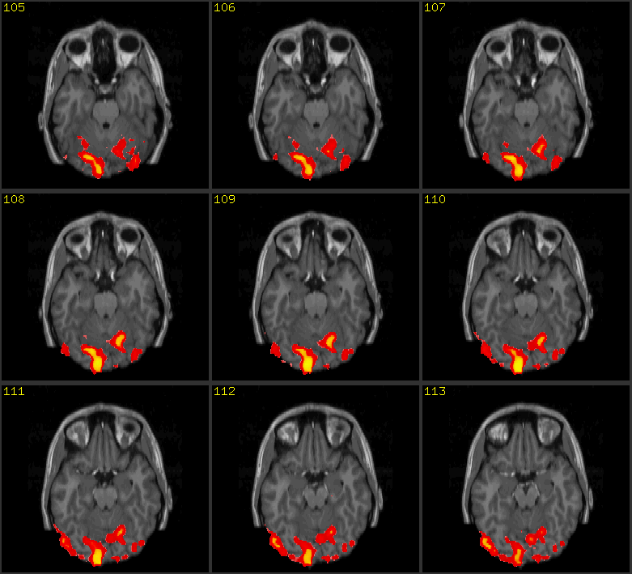
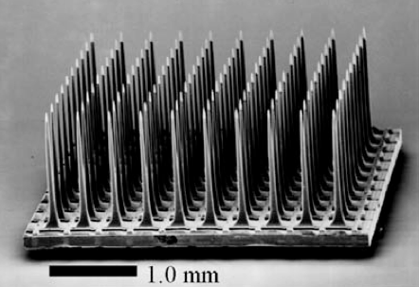
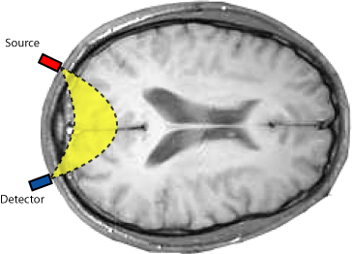
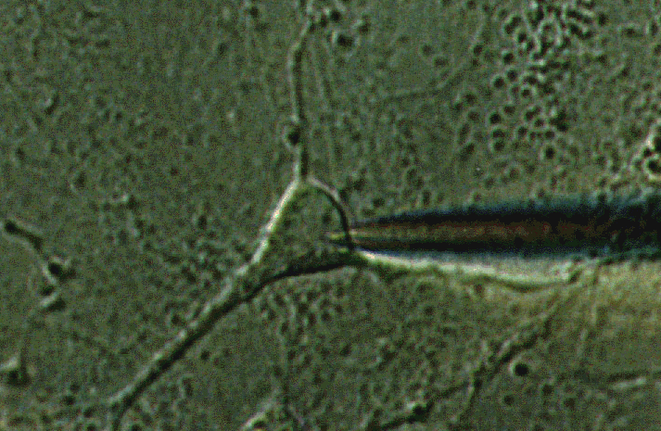
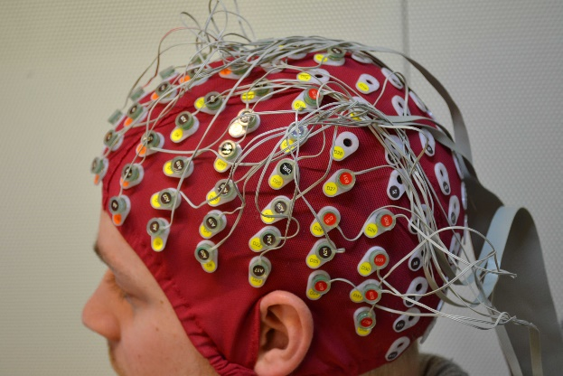
Imaging brain activity
Large area (even whole brain)
Low resolution
Optical calcium or VSD imaging
fMRI
MEA
Patch
clamp
fNIR
EEG
High resolution (even cellular)
Small area
Focus on Microscopy 2015 – Göttingen, Germany, April 1st, 2015
Notes:
fMRI: functional Resonance imaging
Functional Near IR
MEA micro electrode array

Slide 3


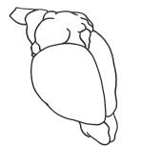
Imaging brain activation
Current in vivo imaging methods cannot afford cellular resolution in the whole brain, at least in mammals. On the other hand, ex vivo technologies, such as serial two-photon or light sheet microscopy, can produce whole-brain images with micron resolution.
The idea is to use a genetic strategy to first label active neurons, and then image the whole fixed brain.
LSM
STP
Microtome
Transgenic mouse expressing a (destabilized) fluorescent protein under the promoter of an immediate early gene (like Arc or c-fos)
Cellular resolution Brain wide
Focus on Microscopy 2015 – Göttingen, Germany, April 1st, 2015
Notes:
Destabilised: last several hours, FP labels neurons that were active shortly before death, here: visual stimuli (light stimulation/deprivation)
Immediate-early gene (IEG): rapidly actived
Highlight: image whole brain for activation of individual neurons NOT activation area

Slide 4
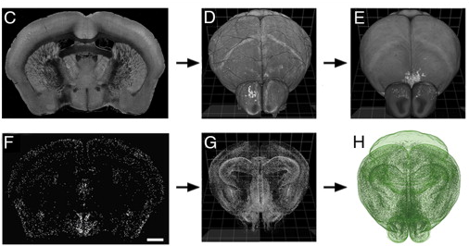
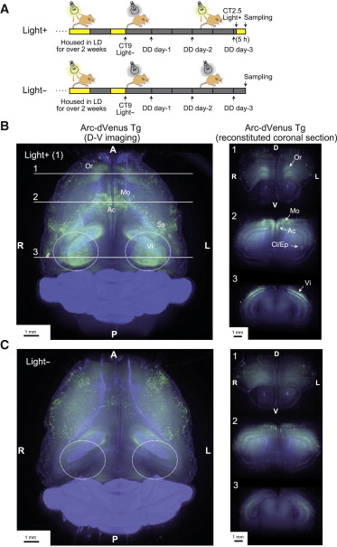
Imaging brain activation
Kim et al., Cell Rep. 2015
Serial two-photon imaging with automatic cell localization
Only 4% of the volume is actually imaged (2 µm thin optical sections every 50 µm)
Susaki et al., Cell 2014
Light sheet full volumetric imaging
No quantitative analysis
Focus on Microscopy 2015 – Göttingen, Germany, April 1st, 2015

Slide 5
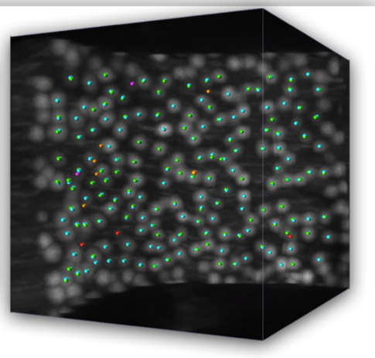
Imaging brain activation
Arc-dVenus transgenic mouse
Light sheet microscopy
Automatic cell localisation
Focus on Microscopy 2015 – Göttingen, Germany, April 1st, 2015
Notes:
Ability to extract quantitative human-readable information from the data

Slide 6
Light-sheet microscopy
Confocal slit detection coupled with digitally scanned light sheet excitation allows for removing of out-of-focus and scattered light, allowing a 100% contrast increase in cleared specimens.
GM galvo mirror, SL scanning lens, Obj microscope objective, TL tube lens, L lens, FF fluorescence filter, EM-CCD electron-multiplying charge-coupled-device.
Silvestri et al., Opt. Exp. 2012
Focus on Microscopy 2015 – Göttingen, Germany, April 1st, 2015

Slide 7
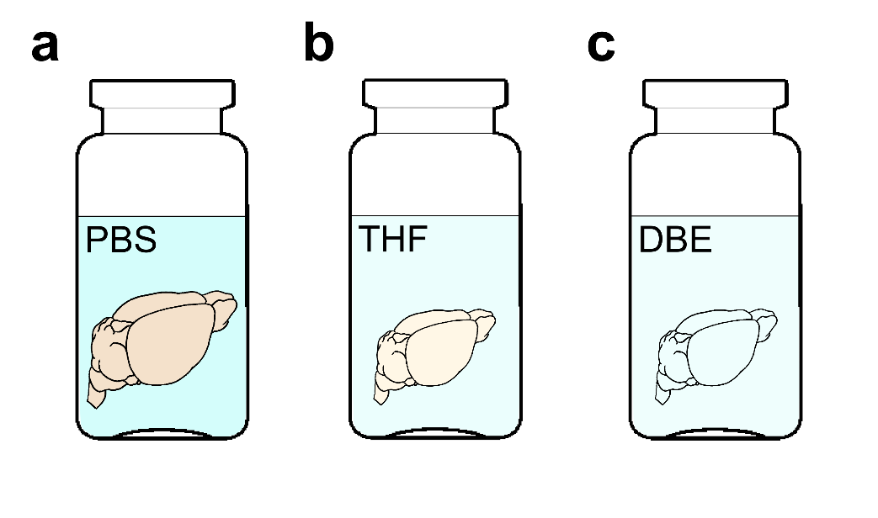
Chemical clearing of the brain
PBS
Mice are transcardially perfused with phosphate-buffered saline (PBS) solution followed by 4% paraformaldehyde (PFA)
Brains are removed from skull, postfixed overnight in PFA and stored in PBS
Samples are dehydrated in a graded series of tetrahydrofuran (THF) in PBS and finally immersed in dibenzyl ether (DBE), an index-matching organic solvent.
DBE
Becker et al., PLoS ONE 2012
Silvestri et al., JoVE 2013
Focus on Microscopy 2015 – Göttingen, Germany, April 1st, 2015

Slide 8
Automatic 3D cell localisation challenges
Very large samples (cm-sized)
Large variability in contrast in different areas
TB-sized datasets
Naïve methods (as thresholding or clustering) are poorly effective as usually depending on sensitive parameters
Advanced methods usually require the calculation of multiple features per each image voxel, leading to a data multiplication which is not manageable with large datasets
Focus on Microscopy 2015 – Göttingen, Germany, April 1st, 2015
Notes:
Different fixation effiencies within whole brain inhomogeneous optical clearing
Algorithms that require carefully tuned parameters cannot cope with the image variability present in large-scale datasets.

Slide 9
Semantic deconvolution
Semantic deconvolution uses a supervised neural network, to enhance selected features of the image reducing the intensity of other structures.
Original image
Deconvolved image
Neural network
This method creates a more uniform image where significant structures (hence the name semantic) are better visible.
In the deconvolved image, easy low-cost localization algorithms (e.g. clustering) can achieve very good performances.
Manual soma localization
Supervision
Ideal image
Only on a small subset
Focus on Microscopy 2015 – Göttingen, Germany, April 1st, 2015
Notes:
Supervised semantic deconvolution by means of NN for image enhancement
Aim: Equalised image in contrast, enhance and standarise the visibility of a specific entities of interest (here soma)
NN is trained to map the original image into an ideal image which is black except for small white spheres positioned at the locations of the true somata cells.
Training of neuronal network with only a small subset (10 substacks, 0,11% of whole cerebellum images, 3h, 1770 cells), the NN is able to generalise well on different brain regions. This suggests the the NN trained on one cell type and one brain will be able to perform SD equally well for the same cell type of other brains within a uniform population of animals.
Training <2d on 16 cores.
Clustering method: collapse group of voxels with similar grey values

Slide 10
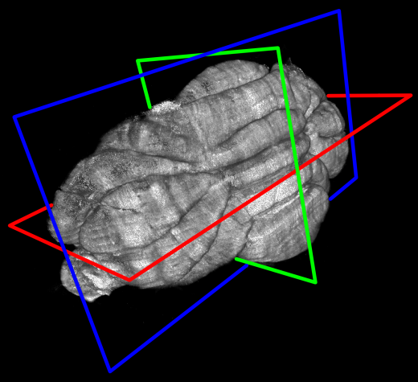
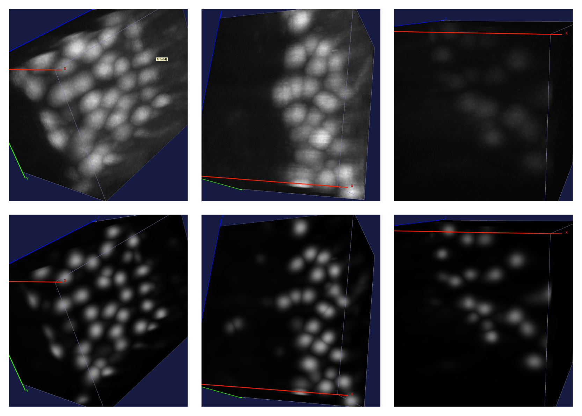
Semantic deconvolution
This method has been successfully applied to localise Purkinje cells in the entire cerebellum of a L7-GFP mouse.
Original
images
Deconvolved
images
Focus on Microscopy 2015 – Göttingen, Germany, April 1st, 2015
Notes:
L7-GFP is a transgenic animal in which the Purkinje cells are labeled with enhanced green fluorescent protein (EGFP).
The algorithm was successfully demonstrated by producing the full map of Purkinje cells in the whole mouse cerebellum.

Slide 11
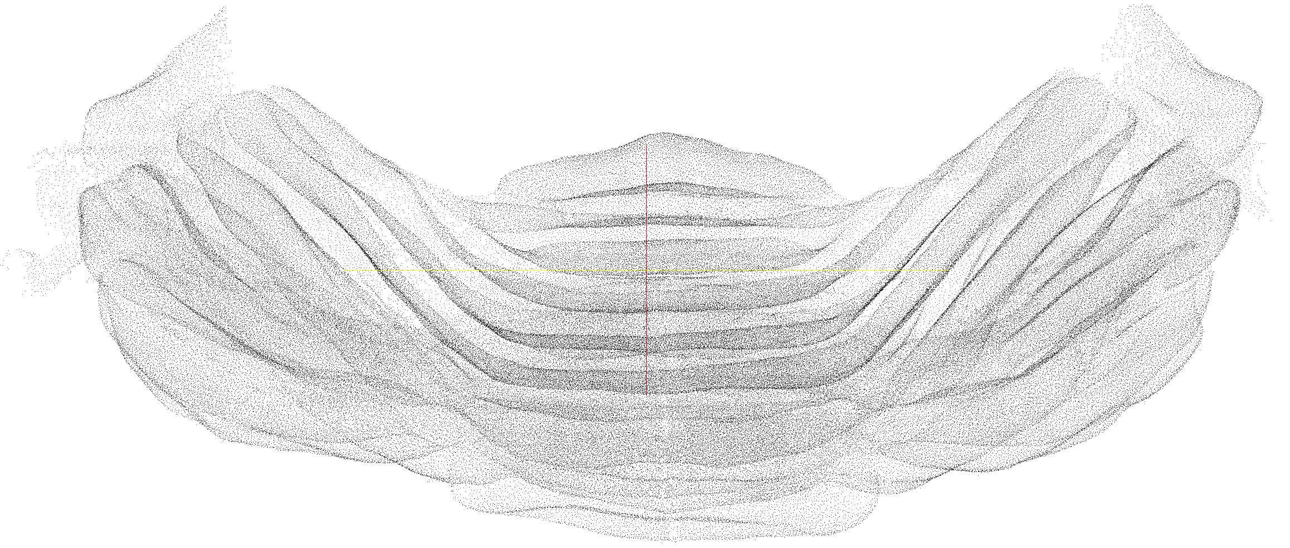
Semantic deconvolution
224’222 Purkinje cells automatically localized in the cerebellum of an L7-GFP mouse. Precision (true positives/all localized cells) is 95%, recall (true positives/all real cells) 97%
~ 1 day of computation on a 16-cores workstation to analyze 120 Gvoxels
Frasconi et al., Bioinformatics 2014
Focus on Microscopy 2015 – Göttingen, Germany, April 1st, 2015
Notes:
Cerebellum: small, scattering not so strong,

Slide 12
Towards localisation of individual neurons in the whole brain
In large cleared specimens, residual scattering inside the tissue reduce the useful amount of photons that can be collected when going deep either in excitation or detection
0°
90°
Detection objective
180°
270°
Image degradation
Scale bar 1 mm
Multi-view imaging can mitigate this problem, as areas which are badly imaged in one view become nicer in another view.
Image degradation
Focus on Microscopy 2015 – Göttingen, Germany, April 1st, 2015
Notes:
Idea: apply same methodology to localise activated neurons at cellular level ( not brain region) in the entire mouse brain
But challenge because mouse brain is huge

Slide 13
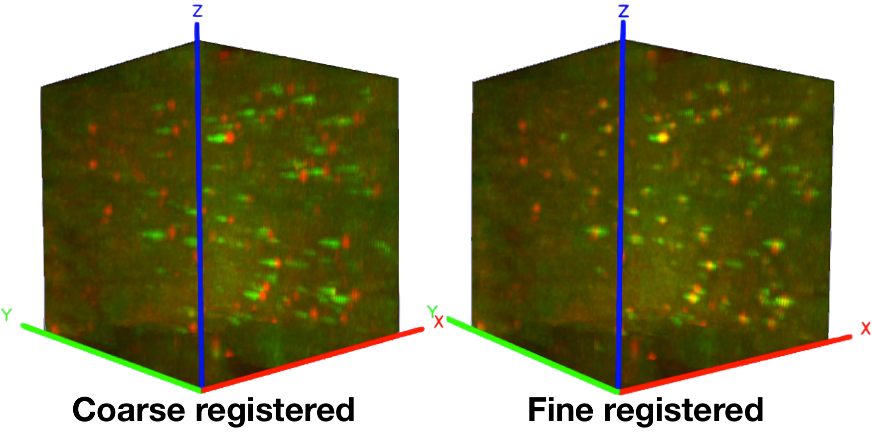
Multi-view registration
0°
The 4 views are first coarsely aligned using manually placed landmarks (about 30-40 per view).
Volumes are then substacked to allow finer local registration based on entropy maximization.
90°
180°
270°
Coarse registration
Focus on Microscopy 2015 – Göttingen, Germany, April 1st, 2015
Notes:
Rigid transformation

Slide 14
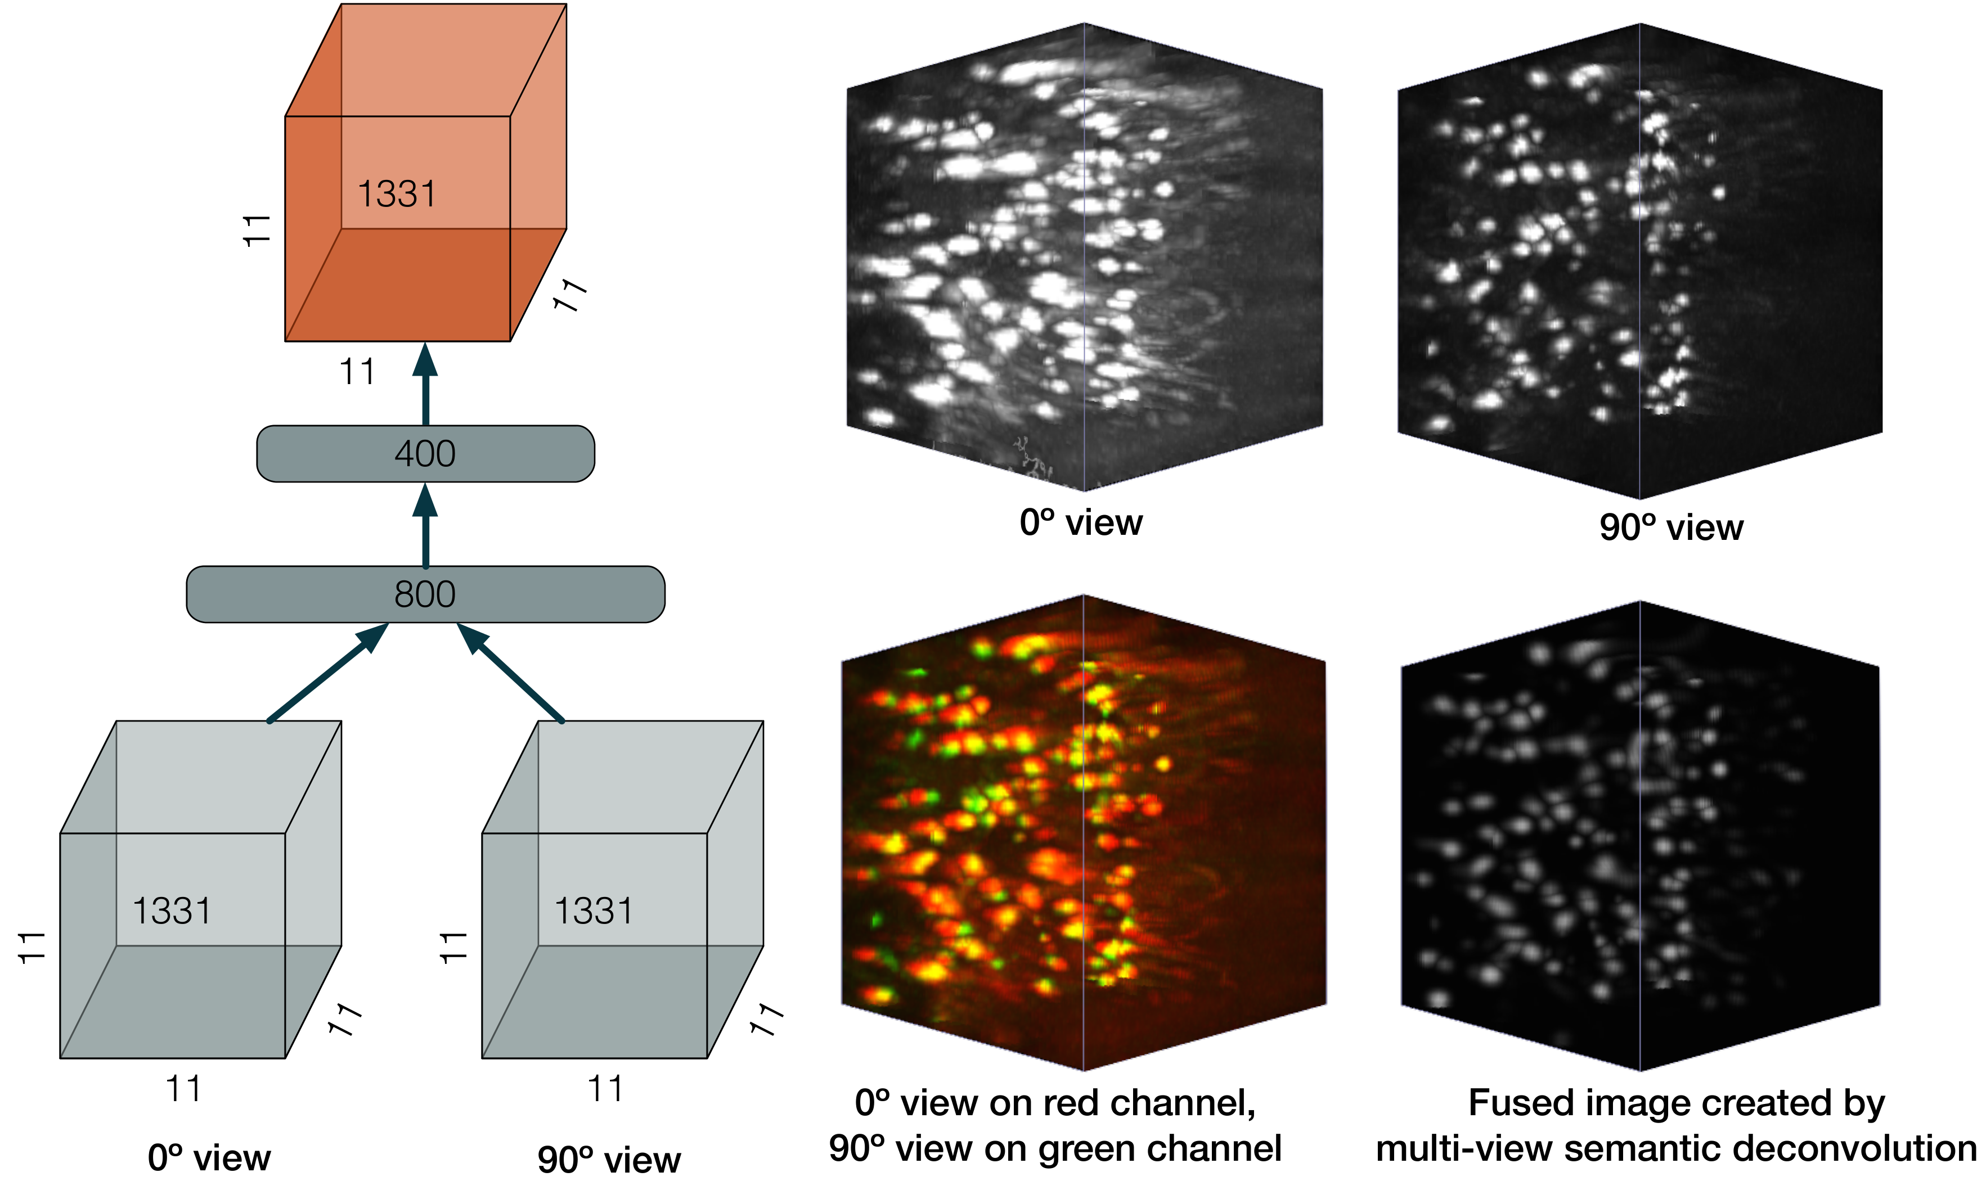
Multi-view semantic deconvolution and fusion
Semantic deconvolution is applied to couple of substacks from adjacent views. The artificial neural network both enhances somata shape and fuses different images. Ground truth sets, used either for training the network or for testing it, are derived by merging manual annotations from two views.
The fusion process helps to homogenize the contrast in the whole brain, as well as to amend resolution anisotropy
Focus on Microscopy 2015 – Göttingen, Germany, April 1st, 2015
Notes:
Ground truth: 56 stacks annotated by hand

Slide 15
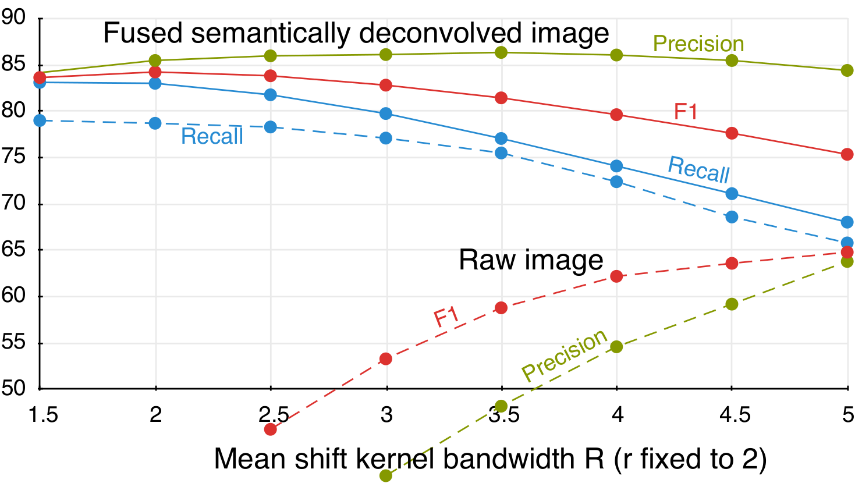
Automatic 3D cell localization
TP: matching ground truth
FP: unmatched predictions
FN: unmatched ground truth
Precision:= TP/(TP+FP)
Recall:= TP/(TP+FN)
F1:= 2PR/P+R
Focus on Microscopy 2015 – Göttingen, Germany, April 1st, 2015
Notes:
Modest sensitivity of performance with respect to the mean shift kernel radius R
SD significantely boosted performance of the mean shift clustering to detect soma centers at a modest cost in terms of hand labeling.
Mean shift algorithm performance increases dramatically when applied to the image cleaned by the semantic deconvolution (much less sensitive to choice of R)
Seed selection parameter r (radius of seed ball) can be set to expected size of visible soma.
FP: unmatched predictions, eg non soma regions which are bright like dendritic arbors or axonal bundles.

Slide 16
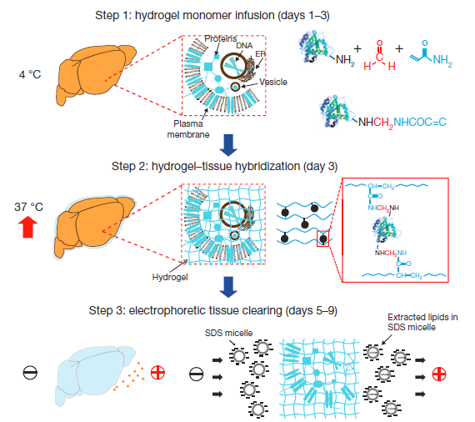
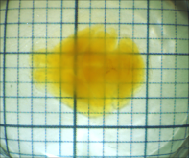
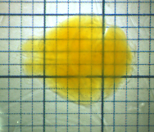
Outlook: improved clearing and microscopy
CLARITY, a new method for tissue transformation and clearing, allows obtaining very transparent brains in an aqueous environment, better preserving protein fluorescence.
FocusClearTM
(original CLARITY protocol)
TDE 63%
We recently found a valid alternative to FocusClear for refractive index homogeneization.
Chung et al., Nature 2013
Costantini et al., Sci. Rep. accepted
Focus on Microscopy 2015 – Göttingen, Germany, April 1st, 2015

Slide 17
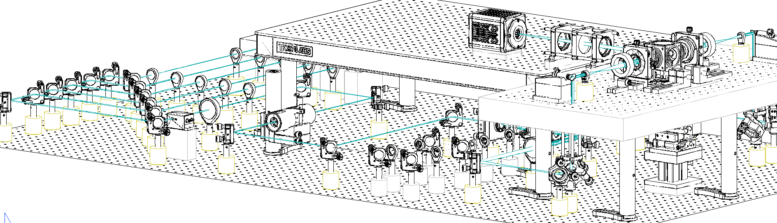
Outlook: improved clearing and microscopy
Specialized optics for clearing solutions, new Olympus objective
Double-sided illumination
Adaptive optical elements for aberration correction
Large-data management infrastructure for reliable streaming and storing of data
Focus on Microscopy 2015 – Göttingen, Germany, April 1st, 2015

Slide 18
Conclusions
These preliminary results pave the way towards a quantitative mapping of neuronal activity across the whole brain with single-cell resolution. The high-throughput of the experimental pipeline will allow comparison of activity patterns between animals subjected to different stimuli and between healthy and diseased mice.
Sample preparation with CLARITY guarantees better fluorescence preservation together with high transparency.
A new light-sheet microscope suited for CLARITY is producing datasets of higher quality.
Semantic deconvolution must be implemented in strongly parallel architectures to be capable of managing TB-sized datasets.
Non-rigid alignment of datasets to standard reference atlases (Allen, INCF) is needed to quantitatively compare different brains.
Focus on Microscopy 2015 – Göttingen, Germany, April 1st, 2015

Slide 19







Acknowledgements
LENS, Florence
Ludovico Silvestri
Irene Costantini
Leonardo Sacconi
Francesco Saverio Pavone
University of Florence
Marco Paciscopi
Paolo Frasconi
Harvard Medical School, Boston
Nikita Rudinskiy
Bradley T. Hyman
Funding:

Slide 20
Thank you for your attention!

Slide 21
Outlook: improved clearing and microscopy
Transverse section of an Arc-dVenus mouse brain processed with CLARITY and imaged with the new microscope.
Focus on Microscopy 2015 – Göttingen, Germany, April 1st, 2015

Slide 22
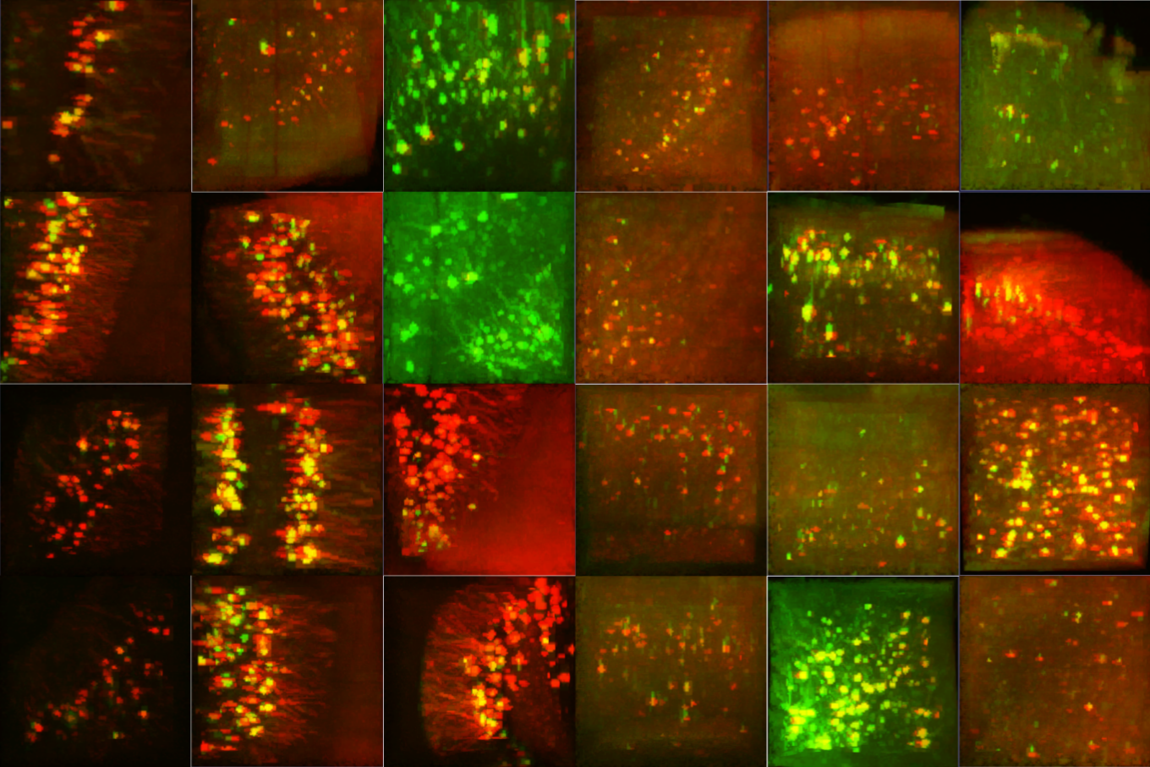
Multi-view registration
Substacking is also useful to locally estimate background tresholds.
Here on the right an example of the high variability of image quality between different views (false red/green colors) in different regions of the specimen.
Focus on Microscopy 2015 – Göttingen, Germany, April 1st, 2015

